Slide 1
law & legal issues

Slide 2
Legal Systems
Intellectual Property
Occupational Health & Safety
Responsibility or Liability

Slide 3
Law & Legal Systems
Laws are established by a competent authority to regulate what is forbidden, required, or acceptable.
Laws are subdivided into
Public Law – governs relations of state or between state and individuals. Example: constitutional law, administrative law, criminal law.
Private Law – governs relations between individuals. Example: contract law, commercial law.

Slide 4
Legal divisions
International Law
Constitutional Law
Administrative Law
Criminal Law
Property Law
Law & Commerce
Law & Society
Intellectual Property
Liability
Health & Safety
Professional Code
Public Law
Private Law

Slide 5
Legal Systems
Legal System:
The existing system for interpreting and enforcing laws
A set of institutions that enforce laws
Different legal systems
Civil Law
English Common Law
Mixed
Religious Law
Customary law

Slide 6
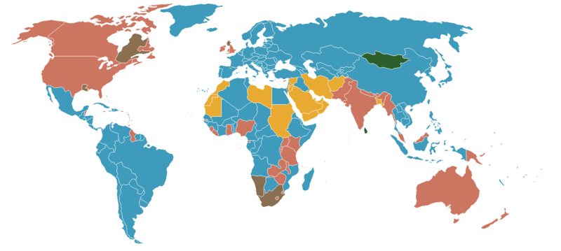
Legal Systems in the World
English Common Law
Civil Law
Mixed Law
Islamic Law

Slide 7
Comparing Legal Systems
Civil Law System
English Common Law
Laws are written into systematic collections (codes).
Laws are created by legislatures
Decisions based on laws
Precedence has no value.
Laws are based on codes and earlier cases.
Laws are created by legislatures & judges
Decisions are based on laws and precedence
Statutes are interpreted based on precedence.

Slide 8
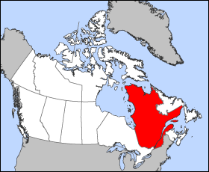
Quebec’s Legal System
Quebec has a mixed legal system
Criminal matters are decided by English Common Law
Property and civil matters are based on the Quebec Civil Code

Slide 9

Civil Code of Quebec
Fundamental law in the Province on disputes between private people and on property.
The Civil Code comprises a body of rules which, in all matters within the letter, spirit or object of its provisions, lays down the “law of the land”, expressly or by implication.
Governs relationship between people and property
Sales, Contracts, Family
Derived from French Civil Law,
Legislation is the primary source of law,
Courts are not dependent on precedent

Slide 10
Intellectual Property

Slide 11
Intellectual Property
Common types of Intellectual Property
Copyrights
Trademarks
Patents
Industrial Design rights
Integrated Circuit Topographies

Slide 12
Canadian Intellectual Property Office
Canadian Intellectual Property Office (CIPO) associated with Industry Canada, is responsible for the administration and processing of the greater part of intellectual property in Canada.
www.cipo.ic.gc.ca
Governed by Federal Statutes
Canada Patent Act, Canadian Copyright Law, Trademark Act, Industrial Design Act, Integrated Circuit Topography Act.

Slide 13
Patents
Patent is a government grant that gives inventors exclusive rights to their inventions.
In Canada the inventors have rights for 20 years from date of filing.
Criteria for patent
Invention must be new
Be useful (functional and operative)
Show inventive ingenuity not obvious to someone with skills.
Invention can be product, chemical composition, process
Cannot be principle, theorem, idea, computer program.

Slide 14
Trademarks
A trade-mark is a word, symbol or design, or a combination of these, used to distinguish the goods or services of one organization from those of others.
3 kinds of trademarks
Ordinary marks are words and/or symbols that distinguish the goods or services of a specific firm. (eg. Dell)
Certification marks identify goods or services that meet a standard set by a governing organization. (eg. Energy Star)
Distinguishing guise identifies the shaping of wares or their containers, or a mode of wrapping or packaging wares. (iPad)

Slide 15
Copyright
Copyright is the exclusive right to allow someone to copy a creative work
Copyright applies to artistic, literary, musical works, computer programs, and sound recordings (CD, tapes).
Not copyright: Facts, themes, ideas, most titles, names, catch-phrases and other short-word combinations.
Copyright is owned by creator, employer or one who commissions it.
Duration of copyright in Canada exists for the life of the creator plus 50 years following death.

Slide 16
Industrial Designs
An industrial design is the features of shape, configuration, pattern or ornament (or any combination of these) applied to a finished article.
It may be, for example, the shape of a table or the ornamentation on the handle of a spoon.
What cannot be protected
the functional features of an article;
a principle of construction, or how an article is built;
the materials used in the construction of an article;
colour per se; or
ideas.

Slide 17
Integrated Circuit Topographies (ICT)
An ICT refers to the three-dimensional configuration of the electronic circuits used in microchips and semiconductor chips.
ICT protection will give you exclusive rights over the copying of the topography and the commercialization of circuits that contain the topography.
Registration grants you exclusive rights for 10 years on your original circuit design.

Slide 18
Occupational Health & Safety

Slide 19
Occupational Health & Safety (OHS)
In Canada, jurisdiction to ensure OHS is shared between federal, provincial and territories.
In general, authority on OHS issues rests with provinces for 90% of Canadian workers.
Canadian Centre for Occupational Health & Safety advances safe and healthy workplaces in Canada.

Slide 20
Occupational Health & Safety
Supervisor’s Responsibilities
to ensure that workers use prescribed protective equipment devices
to advise workers of potential and actual hazards
to take every reasonable precaution in the circumstance for the protection of workers
Employee’s Responsibilities
to work in compliance with OH&S acts and regulations
to use personal protective equipment and clothing as directed
to report hazards and dangers
to work in a manner as required by the employer and use the prescribed safety equipment

Slide 21
Employee’s Rights
To refuse to do unsafe work
To participate in the workplace health and safety activities through Joint Health and Safety Committee (JHSC) or as a worker health and safety representative
To be informed about actual and potential dangers

Slide 22
Due Diligence
Due Diligence is a legal term that suggests that all reasonable precautions, under the particular circumstances, were taken.
"Due diligence" is important as a legal defense for a person charged under occupational health and safety legislation
If charged, a defendant may be found not guilty if he or she can prove that due diligence was exercised

Slide 23
Due Diligence 14-point Checklist (Adapted from the CCOHS web page)
Do you know and understand your safety and health responsibilities?
Do you have definite procedures in place to identify and control hazards?
Have you integrated safety into all aspects of your work?
Do you set objectives for safety and health just as you do for quality, production and sales?
Have you committed appropriate resources to safety and health?
Have you explained safety and health responsibilities to all employees and made sure that they understand it?
Have employees been trained to work safely and use proper protective equipment?
Is there a hazard reporting procedure in place that encourages employees to report all unsafe conditions and unsafe practices to their supervisors?
Are managers, supervisors, and workers held accountable for safety and health just as they are held accountable for quality?
Is safety a factor when acquiring new equipment or changing process?
Do you keep records of your program activities and improvements?
Do you keep records of the training each employee has received?
Do your records show that you take disciplinary action when an employee violates safety procedures?
Do you review your OSH program at least once a year and make improvement as needed?
Will not be in the quiz/exam

Slide 24
Act Respecting Occupational Health & Safety (Quebec)
Introduced in 1979. Act that has
Regulations to deal with
"ordinary" workplaces as well as construction sites, mines and quarries, foundries, shipyards etc.
special topics such as working with explosives, concrete pumps and distribution masts, ice cutting, forestry operations, work in the vicinity of power lines, concrete formwork etc.
Rights to Workers
Right to refuse work
Right to participate in Health & Safety committees
Employer’s Burden: Rights overshadowed by Obligations
Prevention Programmes in various industries according to risk
To eliminate at the source, risks to the health, safety & wellbeing of workers

Slide 25
Responsibility
Moral Responsibility
Responsibility in the Workplace
Legal Responsibility or Liability

Slide 26
Burden of Responsibility
Responsibility – responding or answering for an action performed.
Accounting for individuals actions

Slide 27
Moral Responsibility
Moral basis arises from
Fixing causal agency on the individual who performs the action
Degree of wilful intent – circumstances are important
Roles & Responsibilities
Roles help grounding responsibilities
Roles create expectations
Individuals are held accountable when they do not meet role expectations

Slide 28
Roles & Responsibilities

Slide 29
Responsibility in the Workplace
Responsibility to Employers
Responsibility to the Profession
Responsibility to the Public

Slide 30
Liability or Legal Responsibility
Legal Responsibility is accountability that is backed up by the power of the law.
Liability is contractual or extracontractual in its origin.
Extra-contractual – responsibility that is owed by customs, usage or law
Contractual – responsibility that is owed within the bounds of an explicit contract.

Slide 31
Evolution of Liability - in Common Law
Buyers bore all liability of products bought.
Caveat Emptor – “buyers beware”
You buy products at your own risk
With increasing complexity of products, sellers now bear liability for products
Caveat Vendidor – “Let the seller beware”
Sellers are penalized for negligent designs
Strict Liability/Absolute Liability
Responsibility is assigned in public interest even in the absence of negligence
Responsibility on engineers to consider likely uses and users of products.

Slide 32
Liability in Quebec – in the Civil Code
Civil Liability – Responsibility to pay for damages or harms caused
Compensation is given if three things are established
An act of omission
A consequence
A cause-effect relation between act and consequence

Slide 33
Legal Provisions of Liability in Quebec
Extra-contractual Liability
Contractual Liability
Ownership Liability
Manufacturer’s Liability
Definition of a safety effect
Superior Force
Victim’s knowledge
Intentional Fault
Limitation of Notices
Damages due
Contract of Enterprise
Absence of subordination
Special provisions respecting works
Workmanship

